Slide 1
How to create a set in Alma (using Alma Analytics) of all users that have an expiration date in the past
Yoel Kortick
Senior Librarian
January 2025

Slide 2
Agenda
Introduction
Create an Alma Analytics report of the users
Create a set in Alma from the Analytics report
Check the results of the set
2

Slide 3
Introduction

Slide 4
Introduction
There are situations whereby the institution may wish to create a set of all users which have an expiration date in the past.
One example might be that the institution will first create the set and then later update the expiration date.

Slide 5
Create an Alma Analytics report of the users

Slide 6
Create an Alma Analytics report of the users
In Alma Analytics create a report in the Fulfillment subject area
  Display the "User Primary Identifier" field from the "Borrower Details" folder.
  Display the "Expiry Date" field from the "Borrower Details" folder.
  Filter by the "Expiry Date" field from the "Borrower Details" < today’s date
  Filter by the "Expiry Date" field from the "Borrower Details" is not NULL
Save the report in your institution folder (and remember the exact folder name and report name because we will need it later).
Example on the next slide

Slide 7
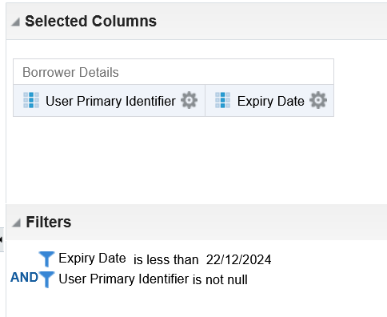
Create an Alma Analytics report of the users

Slide 8
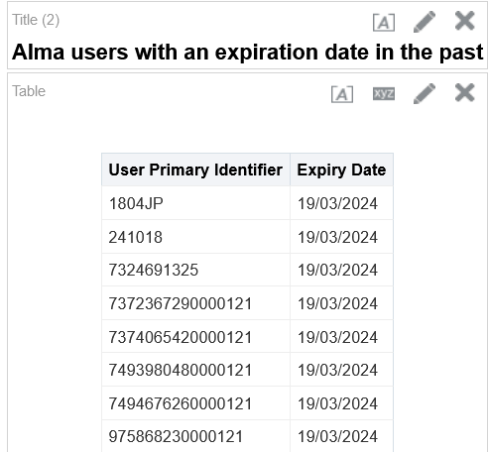
Create an Alma Analytics report of the users
These are the primary identifiers of users with an expiry date earlier than today

Slide 9
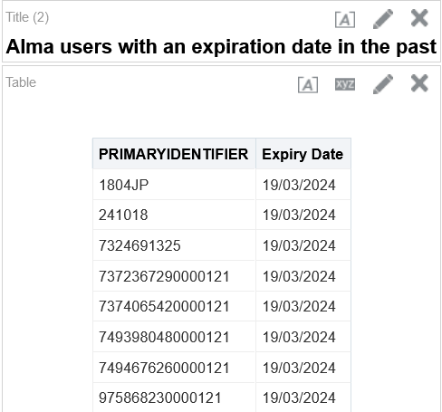
Create an Alma Analytics report of the users
Change the header "Primary Identifier” to "PRIMARYIDENTIFIER”.
For a list of valid headers see the "User” row in the table "Header Types” at Managing Search Queries and Sets

Slide 10
Create a set in Alma from the Analytics report

Slide 11
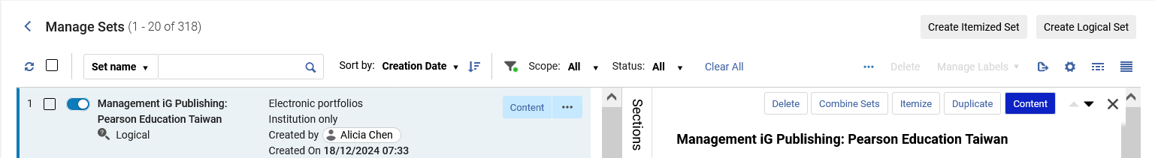
Create a set in Alma from the Analytics report
In Alma Navigate to "Admin > Manage Jobs and Sets > Manage Sets”
Create an Itemized Set

Slide 12
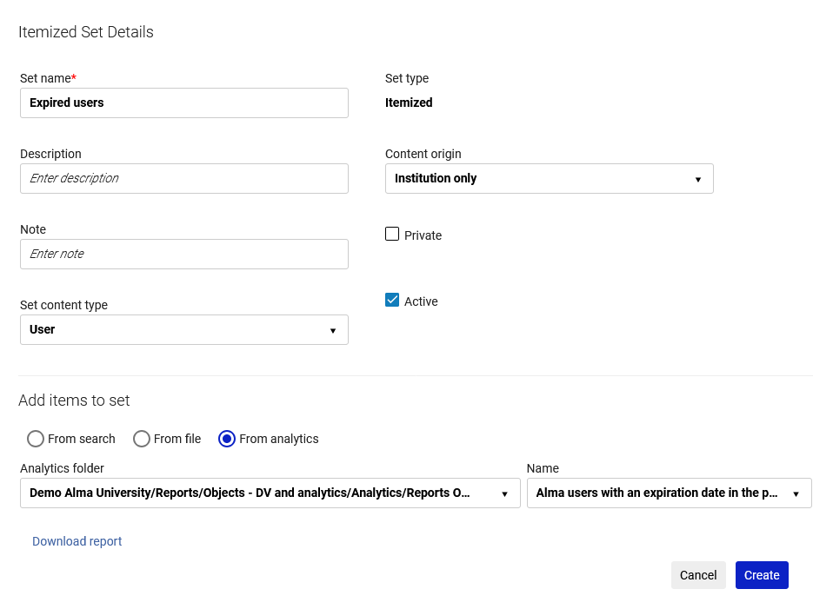
Create a set in Alma from the Analytics report
1. Give the set a name
2. Make the set type "user”
3. Create the set from Analytics
4. Choose folder and report
5. Create

Slide 13
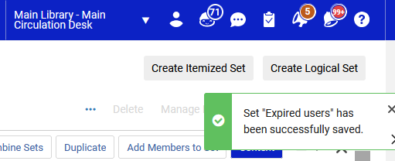
Create a set in Alma from the Analytics report
Receive a message that the set has been saved

Slide 14
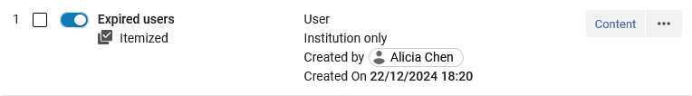
Create a set in Alma from the Analytics report
The set is created

Slide 15
Check the results of the set

Slide 16
Check the results of the set

Slide 17
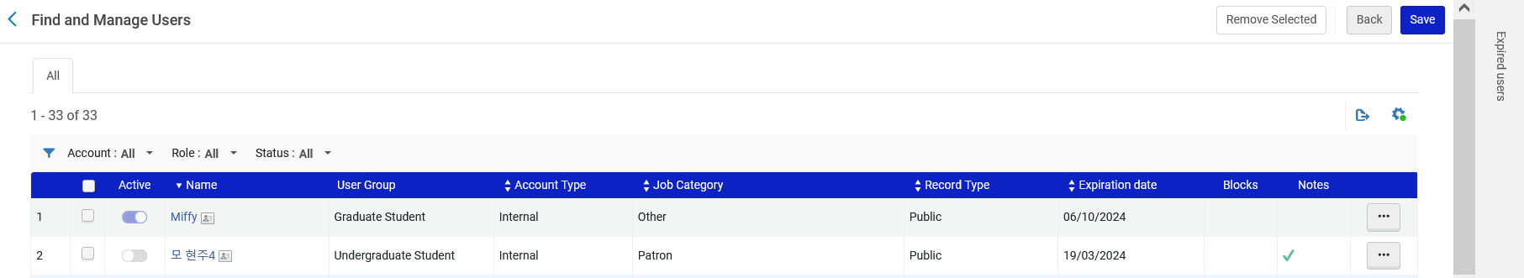
Check the results of the set
The set contains the same users as the analytics report.

Slide 18
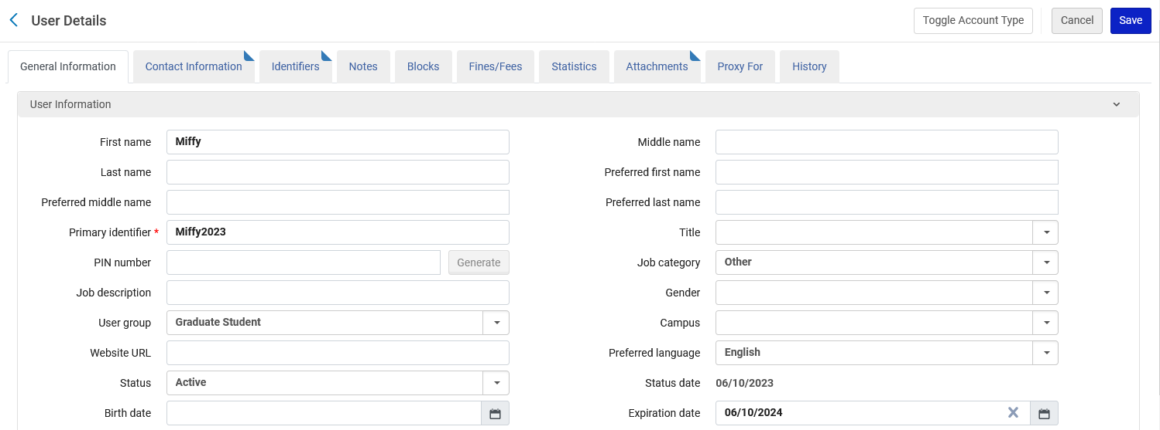
Check the results of the set
Each user in the set has an expiration date earlier than today. Here for example is the first user in the set

